Slide 1

Unit-01
Introduction to Basic Java Programming
Object Oriented Programming using Java (2304CS302)
CO1 : At the end of this course, students will be able to,
use java constructs, features and libraries for simple problems.
Prof. Chirag K Sakhrani
Department of Computer Applications
chirag.sakhrani@darshan.ac.in
8401191184

Slide 2

Outline
Evolution of JAVA
Features of JAVA
JDK, JRE,JVM and Installation
  Configuring JAVA
  Basic structure of Java program
  Compiling Java program
  Running Java program
Identifiers, Data types and Type Casting
Command line arguments
Operators
Operators precedence and associativity
Looping

Slide 3
Evolution of JAVA
Java was created by a team of programmers at Sun Microsystems of U.S.A in 1991.
This language was initially called “Oak” by James Gosling but renamed “Java” in 1995.
Java was designed for the development of software for consumer electronics devices like TVs, VCRs, and such electronics machines.
When the World Wide Web became popular in 1994, sun realized that Java was the perfect programming language for the Web.
Late 1995 and early 1996 they released Java & it was instant success.
Java is small, fast, efficient and easily portable to a wide range of hardware devices.
Java is an object-oriented language and here it differs from C.
Using Java we can create flexible, modular and reusable code.

Slide 4


Evolution of JAVA

Slide 5
Evolution of JAVA
Current Version | Java SE 21 (as of jan-2023)
Version we will use | Java SE 17 (LTS)
Setup size | 155 MB (Linux), 152 MB (Windows x64)
Download Link | https://www.oracle.com/java/technologies/downloads/
Official Website | https://java.com
Integrated Development Environment (IDE) | Eclipse (going to use this IDE in later chapters) NetBeans IntelliJ IDEA Community Edition BlueJ

Slide 6
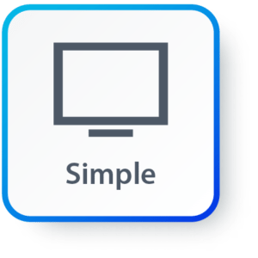
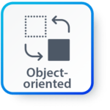
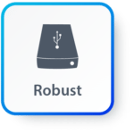

Features of JAVA
Simple: Java inherits C/C++ syntax and many object-oriented features of C++.
Object Oriented: “Everything is an object” paradigm, which possess some state, behavior and all the operations are performed using these objects.
Robust: Java has a strong memory management system. It helps in eliminating error as it checks the code during compile and runtime.
Multithreaded: Java supports multiple threads of execution, including a set of synchronization primitives. This makes programming with threads much easier.

Slide 7



Features of JAVA
Architectural Neutral: Java is platform independent which means that any application written on one platform can be easily ported to another platform.
Interpreted: Java is compiled to byte code, which are interpreted by a Java run-time environment.
High Performance: Java achieves high performance through the use of byte code which can be easily translated into native machine code. With the use of JIT (Just-In-Time) compilers, Java enables high performance.

Slide 8


Features of JAVA
Distributed: Java provides a feature which helps to create distributed applications. Using Remote Method Invocation (RMI), a program can invoke a method of another program across a network and get the output. You can access files by calling the methods from any machine on the internet.
Dynamic: Java has ability to adapt to an evolving environment which supports dynamic memory allocation due to which memory wastage is reduced and performance of the application is increased.

Slide 9
Components of Java
Java Virtual Machine (JVM)
Java Runtime Environment (JRE)
Java Development Kit (JDK)
JDK
Compiler (javac.exe)
Java Application
Launcher (java.exe), AppletViewer, etc..)
Java Packages
(math, util, awt etc…)
JVM
Runtime Libraries
Development tools
JRE

Slide 10
Java Development Kit (JDK)
JDK contains tools to develop the Java programs and JRE to run the programs.
The tools include
  compiler (javac.exe),
  Java application launcher (java.exe),
  Applet viewer, etc…
Java application launcher (java.exe) opens a JRE, loads the class, and invokes its main method.

Slide 11
Java Development Kit (JDK)
JDK Editions
  Java Standard Edition (J2SE)
    J2SE can be used to develop client-side standalone applications or applets.
  Java Enterprise Edition (J2EE)
    J2EE can be used to develop server-side applications such as Java servlets and Java Server Page.
  Java Micro Edition (J2ME)
    J2ME can be used to develop applications for mobile devices such as cell phones.

Slide 12
Java Runtime Environment (JRE)
The JRE is required to run java applications.
It combines the Java Virtual Machine (JVM), platform core classes and supporting libraries.
JRE is part of the Java Development Kit (JDK), but can be downloaded separately.
It does not contain any development tools such as compiler, debugger, etc.

Slide 13
Java Virtual Machine (JVM)
JVM is a virtual machine that enables a computer to run Java programs as well as programs written in other languages and compiled to Java Bytecode.
Bytecode is a highly optimized set of instructions designed to be executed by the Java Virtual Machine(JVM).
Byte code is intermediate representation of java source code.
Java compiler provides byte code by compiling Java Source Code.
Extension for java class file or byte code is ‘.class’, which is platform independent.
JVM is virtual because , It provides a machine interface that does not depend on the operating system and machine hardware architecture.
JVM interprets the byte code into the machine code.
JVM itself is platform dependent, but Java is Not.

Slide 14
How Java become Platform Independent?
Source code (Program)
.java file
Compiler
Bytecode
.class file
JVM
(Windows)
JVM
(Linux)
JVM
(Mac)
Machine Code
Machine Code
Machine Code

Slide 15
Installing JDK
Download JDK for Windows platform (.exe) from
  https://www.oracle.com/technetwork/java/javase/downloads/index.html
Install the executable of JDK
Set the path variable permanently of System variables by performing following steps
  Go to "System Properties" (Right click This PC → Properties → Advanced System Settings)
  Click on the "Environment variables" button under the "Advanced" tab
  Then, select the "Path" variable in System variables and click on the "Edit" button
  Click on the "New" button and add the path where Java is installed, followed by \bin. By default, Java is installed in C:\Program Files\Java\jdk-11.0.1 (If nothing else was specified when you installed it). In that case, You will have to add a new path with: C:\Program Files\Java\jdk-11.0.1\bin
  Then, click "OK", and save the settings
  At last, open Command Prompt (cmd.exe) and type java -version to see if Java is running on your machine

Slide 16
Setting Path variable
The path is required to be set for using tools such as javac, java, etc.
If you are saving the Java source file inside the JDK/bin directory, the path is not required to be set because all the tools will be available in the current directory.
However, if you have your Java file outside the JDK/bin folder, it is necessary to set the path of JDK.
Setting path temporary using following steps:
  Open the command prompt
  Copy the path of the JDK/bin directory
  Write in command prompt: set path=copied path
  For Example: set path=C:\Program Files\Java\jdk1.6.0_23\bin

Slide 17
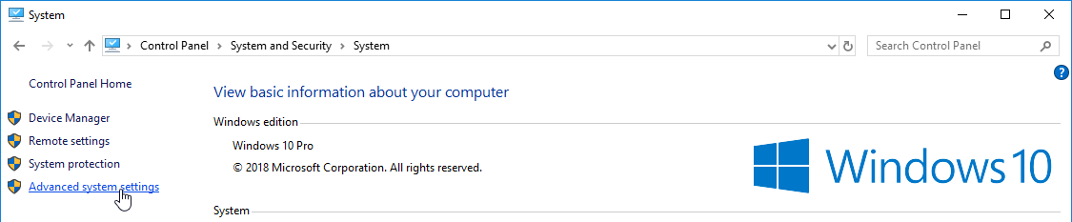
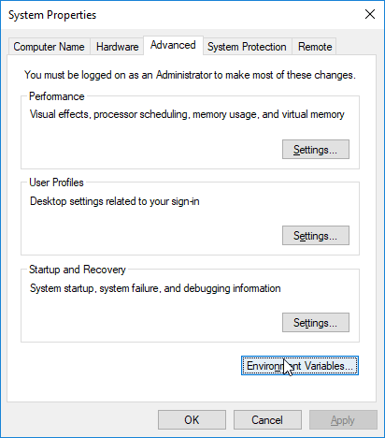
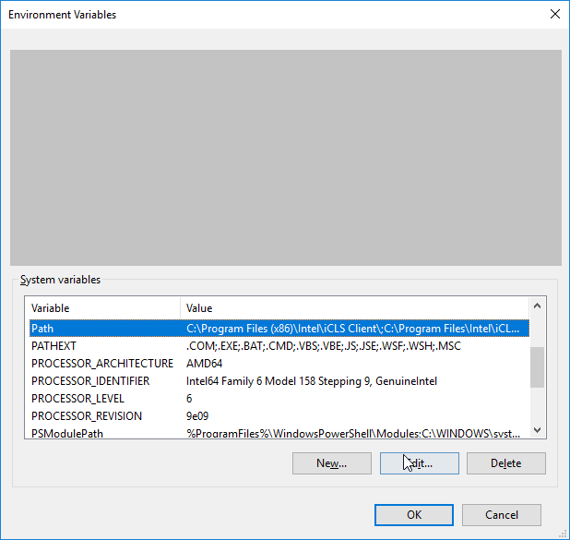
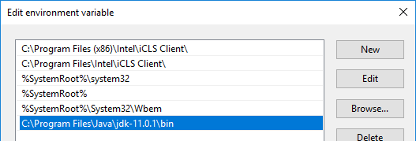
Setting Path Variable
1
2
3
4

Slide 18
Hello World Java Program
File must be saved as HelloWorld.java
public class HelloWorld
{
public static void main(String[] args)
{
System.out.println("Hello World");
}
}
We have to save this in HelloWorld.java file as it has public class named HelloWorld.
String and System are inbuilt Java Classes.
Classes in java are always written in Camel case.
Main method from where execution will start
String must start with capital letter
System must start with capital letter

Slide 19
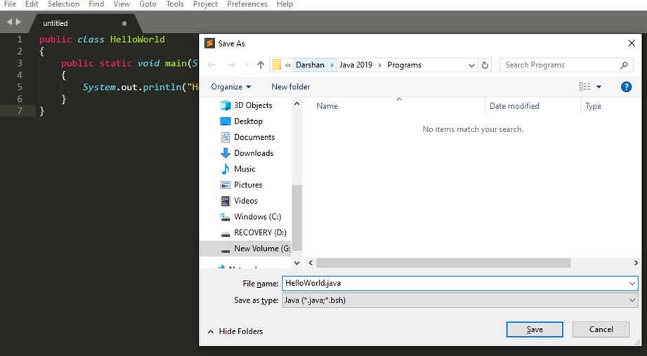
How to execute Java Program?
Save the program with the same name as the public class with .java extension.

Slide 20
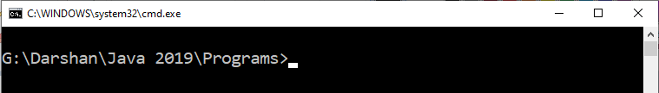
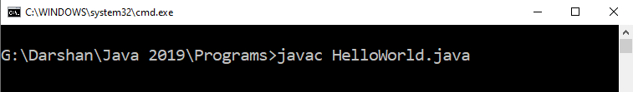
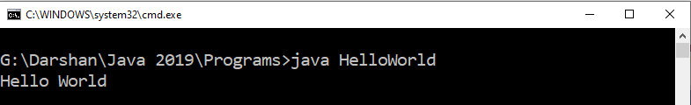
How to execute Java Program?
Open command prompt (cmd) / terminal & navigate to desired directory / folder.
Compile the “.java” file with javac command.
Execute the “.class” file with java command without extension.

Slide 21
Identifiers
Identifiers are used for class names, method names, variable names and more.
An identifier may be any descriptive sequence of
  uppercase(A…Z) and lowercase(a..z) letters
  Numbers(0..9)
  Underscore(_) and dollar-sign($) characters
Rules for Identifiers (other than above mention point)
  There should not be any space in an identifier. For example, darshan uni is an invalid identifier.
  An identifier should not contain a number at the starting. For example, 123darshan is an invalid identifier.
  We can't use the Java reserved keywords as an identifier such as int, float, double, char, etc. For example, int double is an invalid identifier in Java.

Slide 22
Identifiers
Examples for valid Identifiers,
  AvgTemp
  count
  a4
  $test
  this_is_ok
Examples for invalid Identifiers,
  2count
  High-temp
  Ok/NotOK
(Identifiers can not start with digit)
(Identifiers can not contain dash)
(Identifiers can not contains slash)

Slide 23
Identifier Name Valid or Invalid?
for | Rajkot | _Name | If | Roll Number | Rs.
_________a | int | student | _7 | Identifier | Valid
C | C++ | Java | C# | Compiler | ___8__a__8
7Student | Who? | v.a.l.u. | A_B_C_D_E | i | if
Int | A2020 | 2021 | sum | a,b,c | i;

Slide 24
Data Types
Java Data types
Primitive
Non-primitive
Integers
Floating-point numbers
Characters
Boolean
Class

Slide 25
Primitive Data Types
Data Type | Size | Range | Example
byte | 1 Byte | -128 to 127 | byte a = 10;
short | 2 Bytes | -32,768 to 32,767 | short a = 200;
int | 4 Bytes | -2,147,483,648 to 2,147,483,647 | int a = 50000;
long | 8 Bytes | -9,223,372,036,854,775,808 to 9,223,372,036,854,775,807 | long a = 20;
float | 4 Bytes | 1.4e-045 to 3.4e+038 | float a = 10.2f;
double | 8 Bytes | 4.9e-324 to 1.8e+308 | double a = 10.2;
char | 2 Bytes | 0 to 65536 (Stores ASCII of character) | char a = ‘a’;
boolean | 1 Byte | true or false | boolean a = true;

Slide 26
Escape Sequences
Escape sequences in general are used to signal an alternative interpretation of a series of characters.
For example, if you want to put quotes within quotes you must use the escape sequence, \", on the interior quotes.
System.out.println("Good Morning \"World\"");
Escape Sequence | Description
\’ | Single quote
\” | Double quote
\\ | Backslash
\r | Carriage return
\n | New Line
\t | Tab

Slide 27
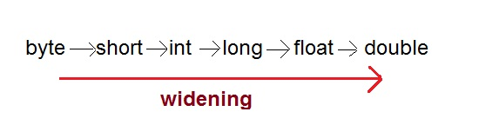
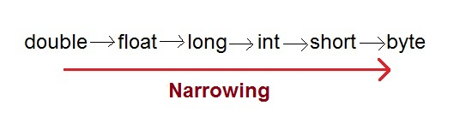
Type Casting
Assigning a value of one type to a variable of another type is known as Type Casting.
In Java, type casting is classified into two types,
  Widening/Automatic Type Casting (Implicit)
  Narrowing Type Casting(Explicitly done)

Slide 28
Automatic Type Casting
When one type of data is assigned to other type of variable , an automatic type conversion will take place if the following two conditions are satisfied:
  The two types are compatible
  The destination type is larger than the source type
Such type of casting is called “widening conversion”.
Example:
  int can always hold values of byte and short
public static void main(String[] args) {
  byte b = 5;
  // √ this is correct
  int a = b;
}

Slide 29
Casting Incompatible Types
To create a conversion between two incompatible types, you must use a cast
A cast is an explicit type conversion.
Such type is called “narrowing conversion”.
Syntax:
  (target-type) value
Example:
public static void main(String[] args) {
  int a = 5;
  // × this is not correct
  byte b = a;
  // √ this is correct
  byte b = (byte)a ;
}

Slide 30
Java Command Line Arguments
The java command-line argument is an argument i.e. passed at the time of running the java program.
The arguments passed from the console can be received in the java program and it can be used as an input.
So, it provides a convenient way to check the behavior of the program for the different values. You can pass N (1,2,3 and so on) numbers of arguments from the command prompt.
Example:
class CommandLineExample{
public static void main(String args[]){
System.out.println("Your first argument is: "+args[0]);
}
}
compile by > javac CommandLineExample.java
run by > java CommandLineExample sonoo
Output: Your first argument is: sonoo

Slide 31
Operators
Arithmetic Operators
Relational Operators
Bitwise Operators
Logical Operators
Assignment Operators
Conditional / Ternary Operator
Instance of Operator

Slide 32
Arithmetic Operator
Note : A = 10 & B = 20
Operator | Description | Example
+ | Addition | A + B = 30
- | Subtraction | A - B = -10
* | Multiplication | A * B = 200
/ | Division | B / A = 2
% | Modulus | B % A = 0
++ | Increment | B++ = 21
-- | Decrement | B-- = 19

Slide 33
Relational Operators
Note : A = 10 & B = 20
Operator | Description | Example
== | Equals | (A == B) is not true.
!= | Not Equals | (A != B) is true.
> | Greater than | (A > B) is not true.
< | Less than | (A < B) is true.
>= | Greater than equals | (A >= B) is not true.
<= | Less than equals | (A <= B) is true.

Slide 34
Bitwise Operators
Note : A = 60 & B = 13
Operator | Description | Example
& | Binary AND Operator | A & B = 12 which is 0000 1100
| | Binary OR Operator | A | B = 61 which is 0011 1101
^ | Binary XOR Operator | A ^ B = 49 which is 0011 0001
~ | Binary Ones Complement Operator | ~A = -61 which is 1100 0011 in 2's complement form due to a signed binary number.
<< | Binary Left Shift Operator | A << 2 = 240 which is 1111 0000
>> | Binary Right Shift Operator. | A >> 2 = 15 which is 1111
>>> | Shift right zero fill operator. | A >>>2 = 15 which is 0000 1111

Slide 35
Logical Operators
Note : A = true & B = false
Operator | Description | Example
&& | Logical AND operator | (A && B) is false.
|| | Logical OR Operator | (A || B) is true.
! | Logical NOT Operator | !(A && B) is true.

Slide 36
Assignment Operators
Operator | Description | Example
= | Simple assignment operator | C = A + B will assign value of A + B into C
+= | Add and assignment operator | C += A is equivalent to C = C + A
-= | Subtract and assignment operator | C -= A is equivalent to C = C - A
*= | Multiply and assignment operator | C *= A is equivalent to C = C * A
/= | Divide and assignment operator | C /= A is equivalent to C = C / A
%= | Modulus and assignment operator | C %= A is equivalent to C = C % A
<<= | Left shift and assignment operator | C <<= 2 is same as C = C << 2
>>= | Right shift and assignment operator | C >>= 2 is same as C = C >> 2
&= | Bitwise and assignment operator | C &= 2 is same as C = C & 2
^= | bitwise exclusive OR and assignment operator | C ^= 2 is same as C = C ^ 2
|= | bitwise inclusive OR and assignment operator | C |= 2 is same as C = C | 2

Slide 37
Conditional Operator (Ternary)
Conditional Operator ( ? : )
  Syntax:
    variable x = (expression) ? value if true : value if false
  Example:
  b = (a == 1) ? 20 : 30;

Slide 38
Operator Precedence & Associativity
How does java evaluate 1 + 10 * 9 ?
  (1 + 10 ) * 9 = 99 OR 1 + (10 * 9) = 91
To get the correct answer for the given problem Java came up with Operator precedence. ( multiplication have higher precedence than addition so correct answer will be 91 in this case)
For Operator, associativity means that when the same operator appears in a row, then to which direction the expression will be evaluated.
How does java evaluate 1 * 2 + 3 * 4 / 5 ???
2 + 12 / 5
2 + 2.4
4.4

Slide 39
Precedence of Java Operators
Category | Operator | Associativity
Postfix | () [] . (dot operator) | Left to right
Unary | ++ - - ! ~ | Right to left
Multiplicative | * / % | Left to right
Additive | + - | Left to right
Shift | >> >>> << | Left to right
Relational | > >= < <= | Left to right
Equality | == != | Left to right
Bitwise AND | & | Left to right
Bitwise XOR | ^ | Left to right
Bitwise OR | | | Left to right
Logical AND | && | Left to right
Logical OR | || | Left to right
Conditional | ?: | Right to left
Assignment | = += -= *= /= %= >>= <<= &= ^= |= | Right to left
Comma | , | Left to right

Slide 40
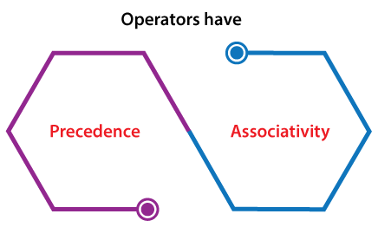
Operators Precedence & Associativity
Operators Precedence and Associativity are two characteristics of operators that determine the evaluation order of sub-expressions in absence of brackets.
Operator precedence determines which operation is performed first in an expression with more than one operators with different precedence.
  a=10 + 20 * 30 is calculated as 10 + (20 * 30) and not as (10 + 20) * 30 so answer is 610.
Operators Associativity is used when two operators of same precedence appear in an expression. Associativity can be either Left to Right (L to R) or Right to Left (R to L).
  a=100 / 10 * 10
    If Left to Right means (100 / 10) * 10 then answer is 100
    If Right to Left means 100 / (10 * 10) then answer is 1
    Division (/) & Multiplication (*) are Left to Right associative so the answer is 100.

Slide 41
Operators Precedence and Associativity
1) Associativity is only used when there are two or more operators of same precedence.
2) All operators with the same precedence have same associativity
Priority | Operator | Description | Associativity
1 | ( ) [ ] . -> a++ a— | Parentheses (function call) Brackets (array subscript) Member selection via object name Member selection via pointer Postfix increment/decrement | left-to-right
2 | ++a —a + – ! ~ (type) * & sizeof | Prefix increment/decrement Unary plus/minus Logical negation/bitwise complement Cast (convert value to temporary value of type) De-reference Address (of operand) Determine size in bytes on this implementation | right-to-left
3 | * / % | Multiplication/division/modulus | left-to-right
4 | + – | Addition/subtraction | left-to-right
5 | << >> | Bitwise shift left, Bitwise shift right | left-to-right
6 | < <= > >= | Relational less than/less than or equal to Relational greater than/greater than or equal to | left-to-right

Slide 42
Operators Precedence and Associativity
Priority | Operator | Description | Associativity
7 | == != | is equal to/is not equal to | left-to-right
8 | & | Bitwise AND | left-to-right
9 | ^ | Bitwise exclusive OR | left-to-right
10 | | | Bitwise OR | left-to-right
11 | && | Logical AND | left-to-right
12 | | | | Logical OR | left-to-right
13 | ? : | Ternary conditional | right-to-left
14 | = += -= *= /= %= &= ^= |= <<= >>= | Assignment Shorthand Assignments Bitwise exclusive/inclusive assignment Bitwise shift left/right assignment | right-to-left
15 | , | Comma (separate expressions) | left-to-right

Slide 43
Exercise
Sr. | Exercise
1. | int i=1; i=2+2*i++;
2. | int a=2,b=7,c=10; c=a==b;
3. | int a=2,b=7,c=10; c=a!=b;
4. | int a=100 + 200 / 10 - 3 * 10
5. | int a = 2, b = 6, c = 12, d; d = a * b + c / b; System.out.println(“The value of d= “+d);
Answer
4
0
1
90
14

Slide 44
FAQ
Describe all java features.
Why java is known as platform independent programming language ?
Describe following terms in detail.
  JDK
  JRE
  JVM
  Bytecode
How can we set path in Java?
Explain datatypes in Java.
Discuss Identifiers in Java.
Describe types of datatype conversion.
Explain java command line arguments.
Demonstrate type of operators with example.
Explain operator precedence and associativity.

Slide 45

Object Oriented Programming using Java (2304CS302)
Prof. Chirag K Sakhrani
Department of Computer Applications
chirag.sakhrani@darshan.ac.in
8401191184

